Slide 1
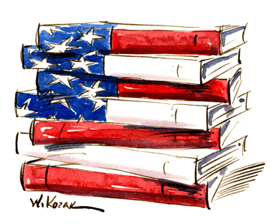
History of American Literature
From storytelling to stateliness
Chapters 10-18
Years: 1806-early 1900’s
Alyssa Holcomb
Per. 1 AP USH
2011

Slide 2
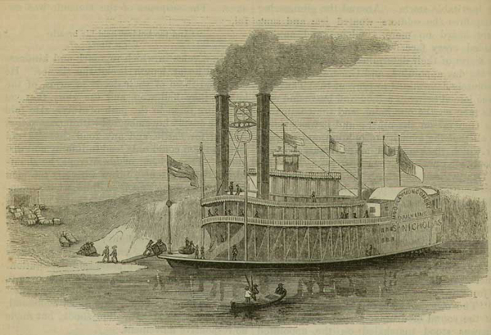
Chapters 10-12 Information
Chapter 10:
-steamboats became a full-fledged power (“symbol of energy and international commerce”) in the early 1800’s → as documented by:
-Mark Twain (from Missouri) “Old Times on the Mississippi”
-“steamboat brought the town to life”
- “serialized in seven issues of The Atlantic Monthly in 1875”
-John C. Calhoun “Exposition and Protest” (1828)
-supported the doctrine of nullification, which “upheld the right of a state to declare a federal law null and void and refuse to enforce it within the state”
-written anonymously since he was Andrew Jackson’s vice president → hoped to gain support, but not so → Calhoun lost all influence w/ Jackson and resigned two years later
→ became a South Carolina senator (replaced in vice presidency by Martin Van Buren)
-publications that helped create the “American culture”

Slide 3
Chapters 10-12 Information
Chapter 10 continued:
-North American Review (Boston)
-“emerged as country’s most important and long-lasting intellectual magazine”
-“developed to keep its readers in touch with European intellectual developments”
-circulation of 3,000 in 1826 → similar to British journals
-Christian Advocate (Methodist in the West)
-25,000 yearly (compared to North American Review’s 3,000)
-New York produced “first widely recognized American writers”
-Washington Irvin “The Sketch Book” (1819)
-“immortalizing Rip Van Winkle and the Headless Horseman”
-James Fenimore Cooper’s Leatherstocking novels, “The Last of the Mohicans’” (1826)
-“wide success in both America and Europe”
-showed “heroic frontiersman Natty Bumppo, modeled after Daniel Boone
-“favored nobility of the Indians even as he participates in their defeat by the forces of civilization”

Slide 4
Chapters 10-12 Information
Chapter 11:
-Solomon Northup “Twelve Years a Slave” (1853)
-“northern free African American kidnapped into slavery”
-forced to do various work → three owners, hired constantly as a carpenter and slave driver in a sugar mill, cleared land for new Louisiana plantation to cute sugar cane, etc.
-Hinton Helper “The Impending Crisis” (1857)
-“published attack on slavery”
-protest = “indicator of growing tensions between the haves and have-nots in the South”
-published in New York → author forced “to move once his views became known”
-the North was also taking a stand on anti-slavery:
-“John Greenleaf Whittier “wrote his short poem "New Hampshire" to honor the Granite State's bold unique stand against slavery in 1846, decades before the Emancipation Proclamation. The final couplet, often quoted, is a stirring call to arms against human bondage with New Hampshire leading the battle:
“Courage, then, Northern hearts! Be firm, be true;
What one brave State hath done, can ye not also do?”

Slide 5
Chapters 10-12 Information
Chapter 12:
-ladies and the writings of the married and their lifestyles:
-John Mather Austin “A Voice to the Married”
-“husband should regard his home as ‘an Elysium to which he can flee and find rest from the stormy strife of a selfish world’”
-Sarah Josepha Hale “Ladies’ Magazine”
-“gave homemakers some help in creating this refuge for their husbands and families”
-“patterns of virtue, of piety, of intelligence and usefulness in private life”
-merged in 1837 w/ Godey’s Lady’s Book (magazine focused on fashion)
-by 1850, the magazine offered to 70,000 → “popular mixture of advice, recipes, and patterns” for simple embroidery, ballgowns, model cottages (new ideal for suburban middle-class homes)
-Catherine Beecher “Treatise on Domestic Economy” (1841)
-“standard guide for a generation of middle-class American women”
-combined “innovative ideas for household designs” with “medical information, child-rearing advice, recipes” and a lot of discussion about “the mother’s moral role in the family”
-Beecher tried to “help women modernize their traditional housekeeping tasks within the context of their newly defined family role”
-only her book and the Bible were carried by many pioneer women of the West
-“maternal organizations” made to help raise their children to be “religious and responsible”
-a lot of this advice in NY came from publications (on next slide)

Slide 6
Chapters 10-12 Information
Chapter 12 continued:
-“Mother’s Magazine” (published by Presbyterian Church)
-“Mother’s Monthly Journal” (published by Baptists)
-obviously, a lot of religious focus
-sentimental novels → concentrating on “private life”
-Susan Warner “The Wide Wide World” (1850 → fourteen editions in two years)
-written after fathers lost their fortunes in Panic of 1837
-followed by works of Lydia Maria Child, Catherine Sedgwick, E.D.E.N. Southworth
-all sold thousands of copies → helped show “vision of responsibility and community based on moral and caring family life”
-Transcendentalism & Self-Reliance
-Ralph Waldo Emerson poems
-“Nature” (1836) & “Self-Reliance” (1841)→ “assertion of individualism”
-Henry David Thoreau
-“Walden” (1854) → criticism of spiritual cost of market revolution
-denounced materialism → led to man’s “desperation”
-Margaret Fuller
-“Women in the Nineteenth Century” (1845)
-“expressed her sense of women’s wasted potential”

Slide 7
Chapters 13-15 Information
Chapter 13:
-population and grimy places (w/ influx of European immigrants)
-Ex: Charles Dickens on Five Points (in comparison to the London slums) in 1842 → “All that is loathsome, drooping and decayed is here…”
-penny papers and dime novels became popular (named by their price)
-New York Morning Post and New York Sun began in 1833
-“lurid headlines” like “Double Suicide”, “Secret Tryst”, “Bloody Murder”
-Police Gazette → popular reading w/ pamphlets about murder trials, swindlers, pirates, etc.
-Walter (Walt) Whitman
-“struggling young newspaperman”/Democratic Party activist/poet
-Franklin Evans, or, The Inebriate in 1842
-Leaves of Grass in 1855 (book of free-verse poems)
-“distilled his passionate love for the variety and commonness of…American people”
-his work was “scandalous” for the time because of frank language
-Edgar Allen Poe’s sinister writing
-The Murders in the Rue Morgue (1841), The Mystery of Marie Roget (1842)
-contemporary American crimes
-women and social communities
-Louisa May Alcott:
-Transcendental Wild Oats → “women were left to do all the work while the men philosophized”
-Little Women

Slide 8
Chapters 13-15 Information
Chapter 13 continued:
-African-American literary advancement
-first newspaper = Freedom’s Journal (written by John Russwurm and Samuel Cornish in 1827)
-Appeal to the Colored Citizens of the World →in 1829 by David Walker
-pamphlet by free man that encourage slave rebellion
-Abolitionists (headed by William Lloyd Garrison)
-1831: published own paper the Liberator (“broke with the gradualist persuaders of American Colonization Society” → referred to African-Americans individually instead of just a group
-narrative and slave books
-American Slavery As It Is → Theodore Weld, 1839 (based off of Angelina Grimke, his wife)
-Uncle Tom’s Cabin → Harriet Beecher Stowe, 1852
-challenging “social norms”
-Letters on the Equality of the Sexes and the Condition of Women → Sarah Grimke, 1838
-“men and women were CREATED EQUAL”

Slide 9
Chapters 13-15 Information
Chapter 14:
-rationale for Manifest Destiny from newspaperman John O’Sullivan → “to overspread the continent allotted by Providence for the free development of our yearly multiplying millions”
-pioneering to West:
-Ex: A Pioneer’s Search for an Ideal Home → Phoebe Judson, 1852 (account of trip in that year to Oregon)
-Democratic Review (newspaper):
-O’Sullivan edited it → supported expansion
-ignored Spanish discovery/conquest of Americas during Mexican Texas era, etc.
-supported by Whigs (like Ralph Waldo Emerson)
-also helped with campaign trails for president (like Mexican-American War hero General Zachary Taylor)
-this war had expanded many things, including territory and campaign trails?

Slide 10
Chapters 13-15 Information
Chapter 15:
-“writers of the American Renaissance”
-Walden → Henry David Thoreau (1854)
-The Scarlet Letter → Nathaniel Hawthorne (1851) & The House of the Seven Gables
-both set in Puritan New England in colonial times
-individual morals faced → Scarlet Letter’s examples:
-Hester Prynne faces judgment for her character after sleeping with another man (not her husband) → focused on bigotry and hypocritical nature of the Puritans (and how the new nation should avoid this)
-Moby Dick → Herman Melville (1851)
-search for whale showed “nature of good and evil and a critique of critique”
-Narrative of the Life of Frederick Douglass → 1845
-most successful = Harriet Beecher Stowe’s Uncle Tom’s Cabin
-literary style mixed with women’s domestic novels → firsthand accounts of escaped slaves and northern abolitionists
-daughter of Lyman Beecher → married Congregational minister
-she was also a member of evangelical movement
-tells story of Uncle Tom being treated cruelly by white overseer Simon Legree (best-seller in 1851)
-praised by President Lincoln in 1863
-black family the Webbs toured northern cities doing dramatic readings of the novel

Slide 11
Chapters 13-15 Information
Chapter 15 continued:
-people trying to get slavery problem solved
-Philadelphia Pennsylvanian → “confident that ‘peace and tranquility’ had been ensured”
-Louisville Journal said “weight seemed to have been lifted from heart of America”
-Twelve Years a Slave → Solomon Northup, 1853
-“told a harrowing tale of being kidnapped in Washington and shipped south”
-N laws about liberty enraged the S → made Compromise of 1850
-Incidents in the Life of a Slave Girl → Harriet Jacobs, 1861
-“Fugitive Slave law made her feel…like a slave [in the North]” (so it wasn’t really a fair compromise)
-the law “brought home the reality of slavery to residents of the free states”
-Letters to Mothers → Lydia Sigourney, 1838
-talked “about the ‘influx of untutored foreigners’ that made the US ‘a repository for the waste and refuse of other nations’”
-wanted women to “organize an internal missionary movement that would carry the principles of middle-class American domesticity to the unenlightened foreigners”
-newspaper (and public’s) reaction to Dred Scott v. Sandford
-Louisville Democrat → right decision, but men must abide by Constitution?
-Georgia Constitutionalist → “Southern opinion now…treason against the Government”
-Northerners disagreed → New York Tribune said decision had no weight morally
-after the South left the Union, the political options changed (and there were things written):
-Northern political options: one suggested by Horace Greeley of the New York Tribune
-“let the seven seceding states ‘go in peace’”

Slide 12
Chapters 16-18 Information
Chapter 16:
-letters written to home from battlefield
-soldiers communicated with family through letters → the remains of these letters helped describe the horrors of Civil War battle
-Ex: Union soldier to father: “You can form no idea of the amount of property destroyed by us on this raid…A tornado 60 miles in width from Chattanooga to this place 290 miles away could not have done half the damage we did.”
-newspapers also showed horrors, mainly economically
-Ex: Harper’s Monthly reported that “the suddenly enriched contractors, speculators, and stock-jobbers…are spending money with a profusion never before witnessed in our country” (“government contracts had exceeded $1 billion)
-Horace Greeley:
-“an early member of the Republican Party and, after initially supporting another candidate, helped to secure the nomination for Abraham Lincoln in 1860”
-“Greeley’s views on the secession crisis were the target of much criticism. He initially argued that the South should be allowed to secede. Later, however, he became a strong supporter of the war effort, but subjected Lincoln to searing criticism for refusing to free the slaves.
-After the war, Greeley supported a general amnesty for Confederate officials and angered many Northerners by signing a bail bond for Jefferson Davis; subscriptions to the Tribune fell by half.”*

Slide 13
Chapters 16-18 Information
Chapter 16 continued:
-North vs. South literary contributions
-South: “Southern literary establishment foresaw the dawning of a new literature. Southern audiences would no longer, in the words of the editor of the Richmond-based Southern Illustrated News, be compelled to read "the trashy productions of itinerant Yankees." Instead, he predicted, the region would enjoy "Southern books, written by Southern gentlemen, printed on Southern type, and sold by Southern publishing houses." And, indeed, by the end of 1862 that newspaper made the claim that the Richmond firm of West & Johnson had published more books from original manuscripts during the past year "than any firm in Yankee land." Nevertheless, the output of belles letters in the Confederacy was what historian Elisabeth Muhlenfeld has characterized as "the perennial poor relation of Southern literature.”**
-“Southern publications: Literary magazines edited and published in Richmond included the Magnolia Weekly, Smith & Barrow's Monthly Magazine, the Southern Illustrated News, The Age, the humor magazine Southern Punch, and, the most prestigious of the lot, the Southern Literary Messenger. Few, however, outlasted the war.”**

Slide 14
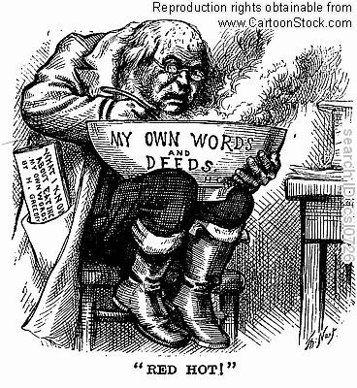
Chapters 16-18 Information
Chapter 17:
-Horace Greeley and the Liberal Republicans
-editor of the New York Tribune
-nominated in spring 1872 to run for president → he was a Democratic Party foe
-nevertheless, he won the party’s favor/ballot
-campaigned against Grant and the South → defeated (Grant had 56% of vote)
-“ In 1872 Greeley received the presidential nomination of both the Liberal Republican and Democratic parties, but his candidacy was doomed from the start. Exhausted by the campaign and distraught with his wife's death, Greeley died a few weeks after the election.”*

Slide 15
Chapters 16-18 Information
Chapter 18:
-Edward Zane Carroll Judson: Buffalo Bill, the King of the Border Men (1869)
-“spawned hundreds of other novels, thousands of stories, and an entire magazine devoted to Buffalo Bill”
-part of the Wild West shows a/ Annie Oakley, etc.
-Lewis Henry Morgan: League of the Ho-de-no-sau-nee, or Iroquois (1851)
-“considered the first scientific account of an Indian tribe”
-next decade: Ancient Society (1877) → “posited a universal process of
social evolution leading from savagery to barbarism to civilization”
-Owen Wister: The Virginian (1902)
-“fixed in the popular imagination the scene of the cowboy facing down the villain and saying ‘When you call me that, smile.’”
-Alice Cunningham Fletcher: Indian Education and Civilization (report for US Senate, 1885)
-“one of the first general statements on the status of Indian peoples”
-met with Suzette (Bright Eyes) Fletcher of Omaha tribe --. Speaking tour to support people → Fletcher became expert on Omaha music → supported campaign to gain individual title to tribal lands
-founder of American Anthropological Society/president of the American Folk-Lore Society → “encouraged further study of Indian societies”

Slide 16
Chapters 16-18 Information
Chapter 18:
-Helen Hunt Jackson: A Century of Dishonor (1881)
-“detailed the mistreatment of Indian peoples” → “lobbied former abolitionists such as Wendell Phillips to work for Indians’ rights and herself began to write against government policy”
-“threw herself” into Indian Rights Association, offshoot of Women’s National Indian Association (WNIA) → formed in 1874 “to rally public support for a program of assimilation”
-“the rise of realism”
-“ The effects of the war also helped to destroy romantic and sentimental modes of writing, whereby writers sought to ennoble their readers, offer ideal visions of society, and avoid the seamy side of life. Realism…emphasized firsthand experience and direct observation in a material world. Realism coincided with the rise of a regimented, corporate society; it sought to depict life in its daily, unheroic, and unsentimental rhythms. Realism rejected the bourgeois emphasis on stability, security, and middle-class values and focused on working-class or morally problematic protagonists.”***
-Ex: Rebecca Harding Davis's novella Life in the Iron Mills
-“ highlights the exploitation of laborers that would only get worse after the war”***
-Mark Twain's Adventures of Huckleberry Finn (1885)
-“written in the vernacular voice of a poor uneducated boy, would have been unthinkable before the war”***

Slide 17
Terms Chapters 10-12
-treatise: a published version of a doctrine, or a document that is outlining the things wrong with something and the steps that should be taken to fix them
Ex: In this section, Catharine Beecher’s “Treatise on Domestic Economy” was used as a “standard guide for a generation of middle-class American women” and the “innovative” domestic “ideas” that should be stressed
-magazine: a type of publication that was populated (in this section) by both religious organizations and women as a way to spread their beliefs and find an audience that agrees with them
Ex: “Mother’s Magazine” (published by Presbyterian Church) and Sarah Josepha Hale’s “Ladies’ Magazine”
-Transcendentalism: a type of focus used by poets and writers in this section as a way of trying to overcome the problems and thought processes of the day and find a new way to live their lives
Ex: the poems and writings of Ralph Waldo Emerson, Henry David Thoreau, and Margaret Fuller
-journal: a type of publication that, similarly to magazines, documented personal accounts that other readers could relate to and use in their own lives
Ex: “Mother’s Monthly Journal” (published by Baptists)
-poem: a creative form of writing that expressed thoughts in flowing language (used particularly in this section in a transcendental way and focus)
Ex: the poems and writings of Ralph Waldo Emerson, Henry David Thoreau, and Margaret Fuller
-“Nature”, “Walden”, etc.

Slide 18
Terms Chapters 13-15
-penny paper: popular form of literature named for its price
Ex: New York Morning Post and New York Sun
-dime novel: popular form of literature named for its price (longer than the papers, used for more than just information)
Ex: Franklin Evans, or, The Inebriate in 1842 by Walt Whitman
-free-verse poems: written as a more creative way to express thoughts in this politically diverse time period
Ex: Leaves of Grass by Walt Whitman in 1855
-pamphlet: another popular form of writing that (similarly to newspapers of the time) would spread a certain idea to people on major issues
Ex: Appeal to the Colored Citizens of the World by David Walker in 1829
-American Renaissance: era where writers like Nathaniel Hawthorne and Herman Melville would write about society and their thoughts on it (and how to change it)
Ex: The Scarlet Letter, Moby Dick

Slide 19
Terms Chapters 16-18
-realism: A term used for the post-War mindset that described how people focused on the actual happenings of the world; the brutality of the war had “destroyed” and/or “killed” any desire for fantasy or romanticism
-Ex: novels of Mark Twain, Nathaniel Hawthorne, etc.
-report: Used for the US government in terms of helping the Indian peoples.
-Ex: Alice Cunningham Fletcher: Indian Education and Civilization (report for US Senate, 1885)
-letter (correspondence): Became a source of news from the battlefront for the people.
-Ex: Union soldier to father (see above)
-publication(s): Publications continued to inform the nation, especially during the war.
-Ex: Horace Greeley’s New York Tribune → major source for news (war and political happenings → affiliation)
-novel: The novel began to represent a new ideal during and post Civil War-era. Specifically, it highlighted both the plights of the Indian peoples and the newly attributed realist mindset.
-Ex: Mark Twain’s “Adventures of Huckleberry Finn”, Helen Hunt Jackson’s “A Century of Dishonor”

Slide 20
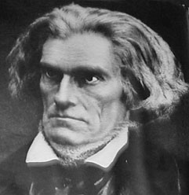
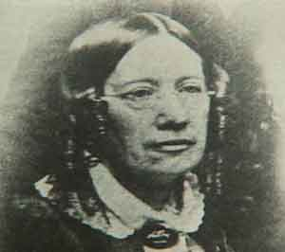
Two Highlighted Figures
Ch. 10-12
Catharine Beecher:
“Treatise on Domestic Economy” (1841)
-“standard guide for a generation of middle-class American women”
-combined “innovative ideas for household designs” with “medical information, child-rearing advice, recipes” and a lot of discussion about “the mother’s moral role in the family”
-tried to “help women modernize their traditional housekeeping tasks within the context of their newly defined family role”
-only her book and the Bible were carried by many pioneer women of the West
John C. Calhoun:
“Exposition and Protest” (1828)
-supported the doctrine of nullification, which “upheld the right of a state to declare a federal law null and void and refuse to enforce it within the state”
-written anonymously since he was Andrew Jackson’s vice president → hoped to gain support, but not so
-Calhoun lost all influence w/ Jackson and resigned two years later → became a South Carolina senator (replaced in vice presidency by Martin Van Buren

Slide 21
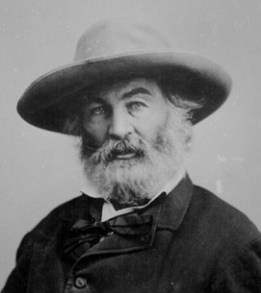
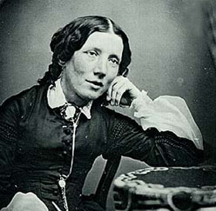
Two Highlighted Figures
Ch. 13-15
Harriet Beecher Stowe:
“Uncle Tom’s Cabin”
-literary style mixed with women’s domestic novels → firsthand accounts of escaped slaves and northern abolitionists
-she was also a member of evangelical movement
-tells story of Uncle Tom being treated cruelly by white overseer Simon Legree (best-seller in 1851)
-praised by President Lincoln in 1863
-black family the Webbs toured northern cities doing dramatic readings of the novel
Walter (Walt) Whitman:
Author during penny papers and dime novels popularity
-“struggling young newspaperman”/Democratic Party activist/poet
-Franklin Evans, or, The Inebriate in 1842
-Leaves of Grass in 1855 (book of free-verse poems)
-“distilled his passionate love for the variety and commonness of…American people”
-his work was “scandalous” for the time because of frank language

Slide 22
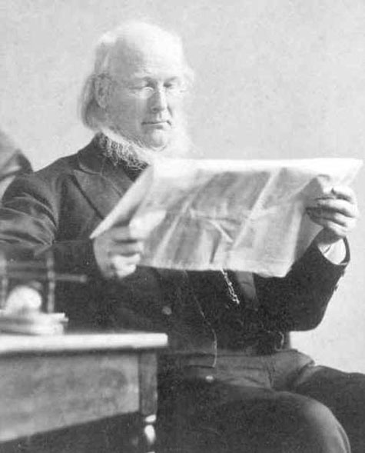
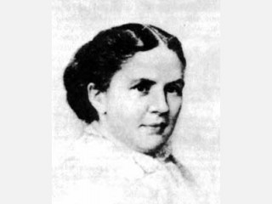
Two Highlighted Figures
Ch. 16-18
Alice Cunningham Fletcher:
Indian Education and Civilization (report for US Senate, 1885)
-“one of the first general statements on the status of Indian peoples”
-met with Suzette (Bright Eyes) Fletcher of Omaha tribe --. Speaking tour to support people → Fletcher became expert on Omaha music → supported campaign to gain individual title to tribal lands
-founder of American Anthropological Society/president of the American Folk-Lore Society → “encouraged further study of Indian societies”
Horace Greeley:
-“an early member of the Republican Party and, after initially supporting another candidate, helped to secure the nomination for Abraham Lincoln in 1860”
-“Greeley’s views on the secession crisis were the target of much criticism. He initially argued that the South should be allowed to secede. Later, however, he became a strong supporter of the war effort, but subjected Lincoln to searing criticism for refusing to free the slaves.
-editor of the New York Tribune
-nominated in spring 1872 to run for president → he was a Democratic Party foe
-nevertheless, he won the party’s favor/ballot
-campaigned against Grant and the South → defeated (Grant had 56% of vote)

Slide 23
Questions Chapters 10-12
1. Which magazine was published by the Presbyterian Church?
a. Mother’s Magazine b. Mother’s Monthly Journal c. Ladies’ Magazine
2. Which transcendental writer wrote the piece “Nature”?
a. Henry David Thoreau b. Ralph Waldo Emerson c. Margaret Fuller
3. Which publication was released by the Baptist religious following?
a. Mother’s Monthly Journal b. Ladies’ Magazine c. Treatise on Domestic Economy
4. Political writer John C. Calhoun was vice president under who’s presidential term?
a. George Washington b. Abraham Lincoln c. Andrew Jackson
5. Which of the following wrote “Treatise on Domestic Economy”?
a. Margaret Fuller b. Catharine Beecher c. Susan Warner

Slide 24
Questions Chapters 10-12
6. Which classic author wrote about the effect of steamboats on American
economy and culture?
a. Mark Twain b. Ralph Waldo Emerson c. John Adams
7. James Fenimore Cooper’s Leatherstocking novels are better known as what?
a. “The Last of the Mohicans” b. “Nature” c. “Walden”
8. Susan Warner wrote which sentimental novel?
a. On the Waterfront b. The Wide Wide World c. Mississippi Burning
9. Washington Irvin “immortalized Rip Van Winkle and the Headless Horseman” in which book?
a. The Last of the Mohicans b. Self-Reliance c. The Sketch Book
10. Where was Hinton Helper’s “The Impending Crisis” published?
a. Georgia b. Mississippi c. New York

Slide 25
Answers Chapters 10-12
1. A 6. A
2. B 7. A
3. A 8. B
4. C 9. C
5. B 10. C

Slide 26
Questions Chapters 13-15
1. Which of these books was written by Louisa May Alcott?
  The Scarlet Letter b. Little Women c. Moby Dick
2. Which famous author wrote about the trials of slavery in Uncle Tom’s Cabin?
  Harriet Beecher Stowe b. Louisa May Alcott c. Herman Melville
3. Writers including Nathaniel Hawthorne and Herman Melville were part of this literary time period.
  a. American Renaissance b. European Renaissance c. Civil War
4. Who was the editor of the Democratic Review for the majority of this politically diverse period?
  a. Walt Whitman b. Abraham Lincoln c. John O’Sullivan
5. Which of these types of publications did Walt Whitman become most famous for?
  a. Free-verse poems b. Newspapers c. Essays

Slide 27
Questions Chapters 13-15
6. What was the name of the first published African-American newspaper?
  a. The Abolitionist b. Freedom’s Journal c. The Philadelphia Pennsylvanian
7. Who published and wrote the first published African-American newspaper?
  Nathaniel Hawthorne and Herman Melville b. Walt Whitman and Louisa May Alcott c. John Russwurm and Samuel Cornish
8. Which of these papers are NOT listed as “penny papers?”
  a. New York Sun b. Louisville Journal c. New York Morning Post
9. The Democratic Review was supported by the ________.
  a. Whigs b. Liberals c. Federalists
10. Sarah Grimke wrote _____________________ in 1838.
  a. Letters on the Equality of the Sexes and the Condition of Women
  b. Letters to Mothers c. Leaves of Grass

Slide 28
Answers Chapters 13-15
1. B 6. B
2. A 7. C
3. A 8. B
4. C 9. A
5. A 10. A

Slide 29
Questions Chapters 16-18
1. Name the infamous editor of the New York Tribune that ended up running for president after the Civil War.
a. Nathaniel Hawthorne b. Mark Twain c. Horace Greeley
2. Who wrote “Indian Education and Civilization?”
a. Mark Twain b. Alice Cunningham Fletcher c. Helen Hunt Jackson
3. Which of these authors are not considered part of the post-Civil War realist era?
a. Mark Twain b. Rebecca Harding Davis c. Voltaire
4. Which of these men beat out Horace Greeley for the presidency?
a. Grant b. Harding c. Jefferson
5. Lewis Henry Morgan wrote which of these pieces?
a. League of the Ho-de-no-sau-nee, or Iroquois (1851) b. Moby Dick
c. Indian Education and Civilization

Slide 30
Questions Chapters 16-18
6. When did Owen Wister publish The Virginian?
a. 1900 b. 1902 c. 1909
7. What “mindset” was prominent after the Civil War?
a. Romanticism b. Communism c. Realism
8. Edward Zane Carroll Judson wrote which of the following?
a. Buffalo Bill, the King of the Border Men b. Moby Dick
c. A Century of Dishonor
9. Which of the following is a work by Mark Twain?
a. Moby Dick b. The Scarlet Letter c. Adventures of Huckleberry Finn
10. Which tribe helped Alice Cunningham Fletcher with her writing (hint: she became an “expert” in their music)?
a. Omaha b. Cherokee c. Navi’i

Slide 31
Answers Chapters 16-18
1. C 6. B
2. B 7. C
3. C 8. A
4. A 9. C
5. A 10. A

Slide 32
Sources (Information)
Book (textbook used in all chapters):
Faragher, J.M., Buble, M.J., Czitrom, D., & Armitage, S.H. (2002). Out of Many, A History of the American People. Upper Saddle River, N.J.: Prentice Hall.
Online:
Chapter 10-12:
Mark Twain, William Dean Howells and “Old Times on the Mississippi.”
Retrieved November 7, 2010, from TwainWeb Website: http://www.twainweb.net/filelist/howe1.html
Whittier’s Anti-Slavery Ode to New Hampshire. Retrieved November 7, 2010, from Seacoast New Hampshire Website:
http://www.seacoastnh.com/blackhistory/whittier.html
Chapter 13-15:
Textbook used only – see above sources
Chapter 16-18:
*Horace Greeley: Ideas and Movements, 1811-1872. Retrieved December 28, 2010, from United States History Website:
http://www.u-s-history.com/pages/h150.html
**Popular Literature During the Civil War. Retrieved December 28, 2010, from Encyclopedia Virginia:
http://www.encyclopediavirginia.org/Popular_Literature_During_the_Civ il_War
***Civil War: American History Through Literature. Retrieved December 28, 2010, from ENotes Website:
http://www.enotes.com/american-history-literature-cc/civil-war

Slide 33
Sources (Images)
Background:
Patriotic Background. Retrieved October 17, 2010, from Wayne Township informational Web site: http://wayne-township.info
Title Slide Image:
US Flag American Literature 72 image. Retrieved October 17, 2010, from Wordpress Web site: http://joefelso.files.wordpress.com/
Chapter 10-12 Images:
Catherine Beecher. Retrieved December 28, 2010, Google Images,
http://www.roebuckclasses.com/people/images/catherine-beecher.jpg
John C. Calhoun. Retrieved December 28, 2010, Google Images,
http://www.nndb.com/people/902/000043773/calhoun55.jpg
Steamboat. Retrieved December 28, 2010, Google Images, http://lincoln.lib.niu.edu/gal/steamboat.jpg

Slide 34
Sources (Images)
Chapter 13-15 Images:
Harriet Beecher Stowe. Retrieved December 28, 2010, Google Images, http://www.nndb.com/people/451/000048307/stowe-crop.jpg
Walt Whitman. Retrieved December 28, 2010, Google Images,
http://www.nndb.com/people/873/000031780/137-crop.jpg
Chapter 16-18 Images:
Alice Cunningham Fletcher. Retrieved December 28, 2010, Google Images,
http://www.browsebiography.com/images/1/5728Alice%20Cunningham%20Fletcher_biography.jpg
Horace Greeley. Retrieved December 28, 2010, Google Images, http://mysierramountaintimes.com/wp-content/uploads/2007/10/20071026_25.jpg
Horace Greeley (cartoon). Retrieved December 28, 2010, Google Images, http://www.cartoonstock.com/lowres/csl0726l.jpg

